Slide 1

The Effect of Default Options on Consumer Decisions in the Product Configuration Process
Yue Wang, Daniel Y. Mo
Hang Seng Management College, Hong Kong
September 28th, 2018
The 20th Configuration Workshop, Graz, Austria

Slide 2
My research
Interest:
  Consumer decision making
  Consumer behavior in product design
  UX in product customization, e.g. B2C configurator
Methodologies:
  Machine learning
  Empirical experiment

Slide 3
Results on configurator research
Adaptive attribute selection in configuration (IEEE-IEEM 2007, AIEDAM 2011, IJPR 2014)
Configuration-then-recommendation (JIM 2014)
Configuring products using natural language input (in progress)
Consumer behavior during configuration process
  Multiple choices (IEEE-IEEM 2017)
  Observational learning effect (IEEE-IEEM 2018)
  Default options (CWS 2018)
Notes:
Mittal and freyman

Slide 4
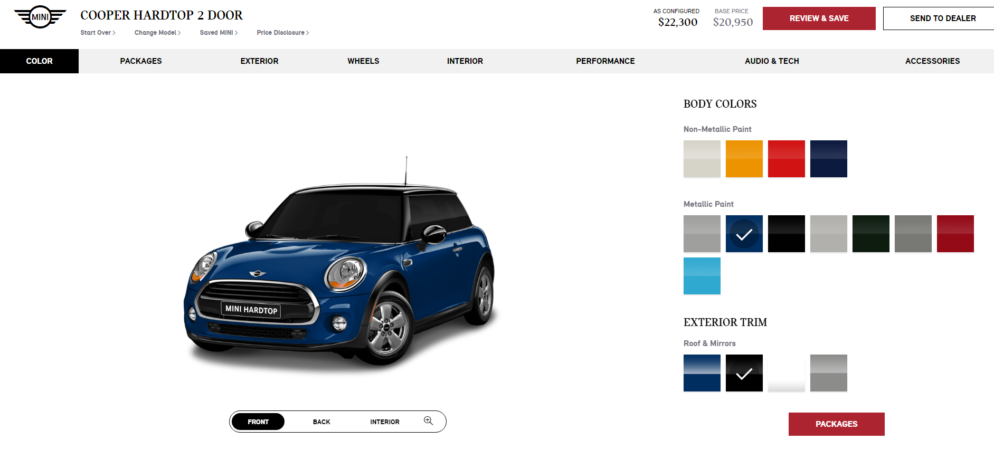
Default options in online configurator
Screenshot of minicooper in May 2017
http://www.miniusa.com/content/miniusa/en/tools/learning/build/build.html#/config/cooper/build/0/

Slide 5
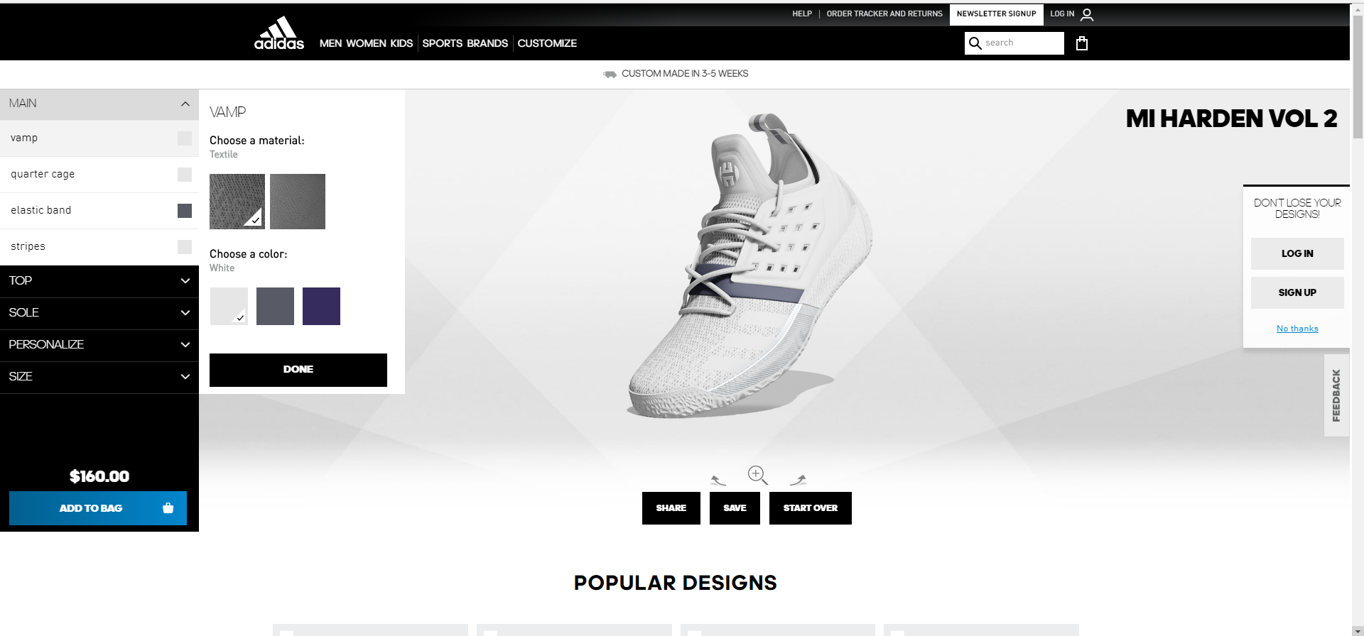
Default options in online configurator

Slide 6
Relevant research
Marketing, psychology and economics
  Attention based default (Johnson et al., 2002)
  Information based fault (Brown and Krishna, 2004)
  Novice customers tend to accept default options (Wang et al., 2013)
  ……
Configuration
  Status quo effect in configuration process (Mandl and Felfernig, 2010)
  Defaults in configurators can increase sales (Herrmann et al., 2011)

Slide 7
Research question
Which factors are significant in the selection of default choices, particularly in the context of product configuration?

Slide 8
Potential influencing factors
Product type
Expertise
Number of choices
Order of attributes
Concern about attribute

Slide 9
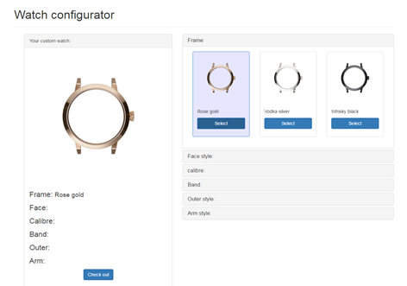
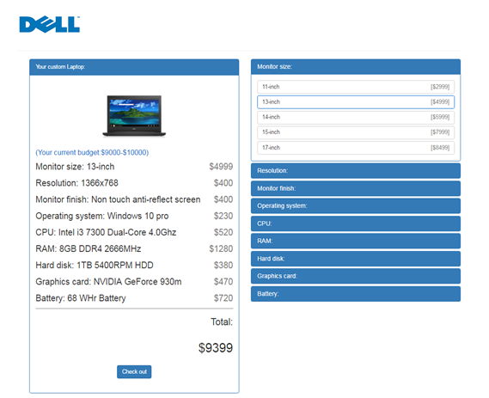
Experiment design
 | Control (configurator w/o defaults) | Treatment (configurator w/ defaults)
Laptop (utilitarian product) | I | II
Watch (hedonic product) | III | IV
Notes:
2x2 factorial design

Slide 10
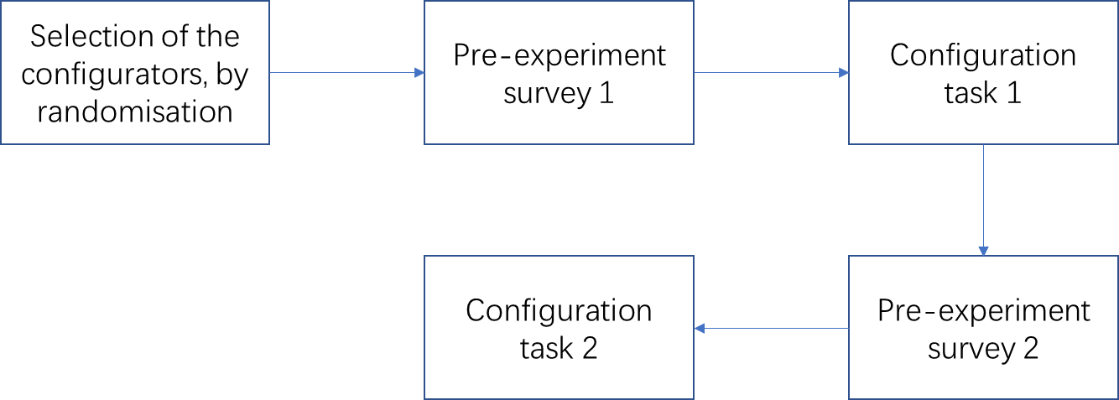
Experiment procedure
Pre-survey: to elicit subjects’ expertise degree and concern about attributes

Slide 11
Experiments
140 subjects
Each subject is randomly assigned to two configuration tasks.
The default option is randomly selected in each round.

Slide 12
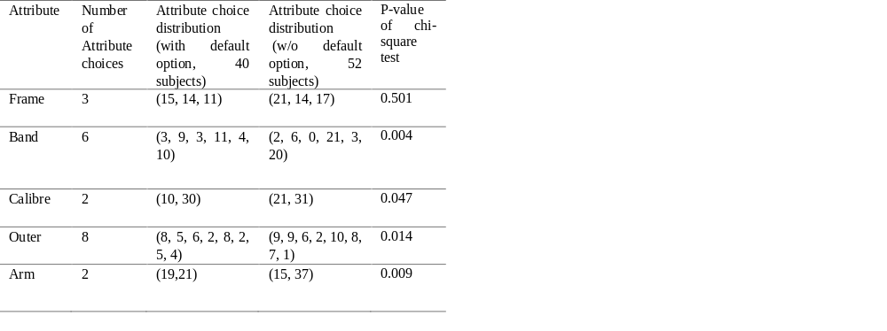
Will default options affect people’s decision?
Consumers’ choice distribution for watch attributes

Slide 13
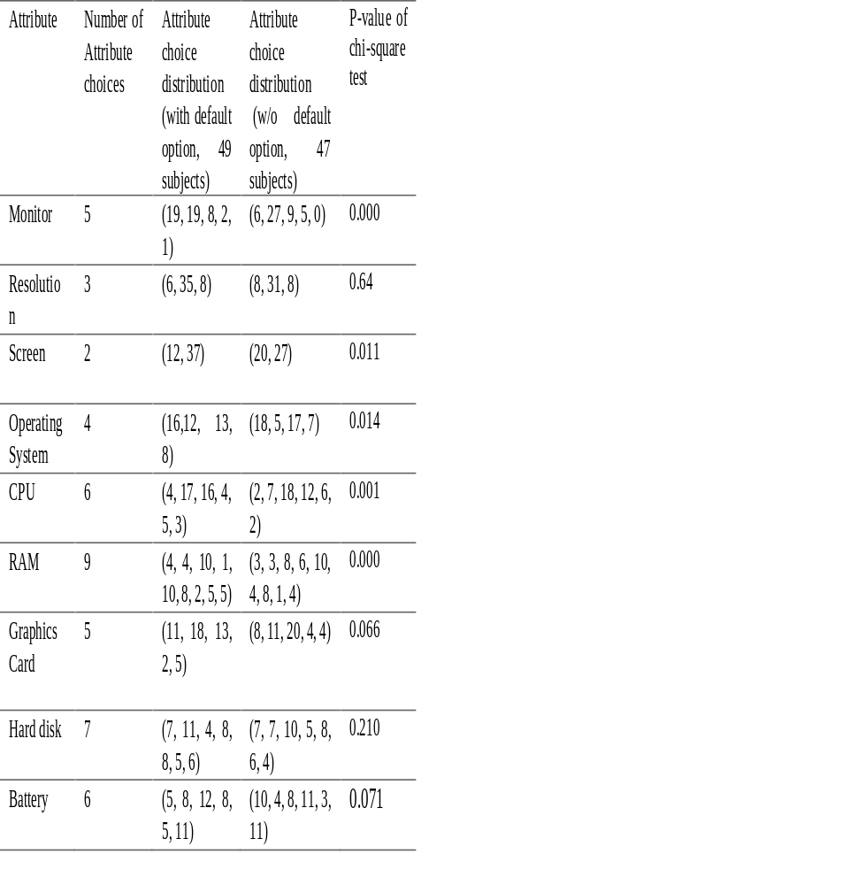
Will default options affect people’s decision?
Consumers’ choice distribution for laptop attributes

Slide 14
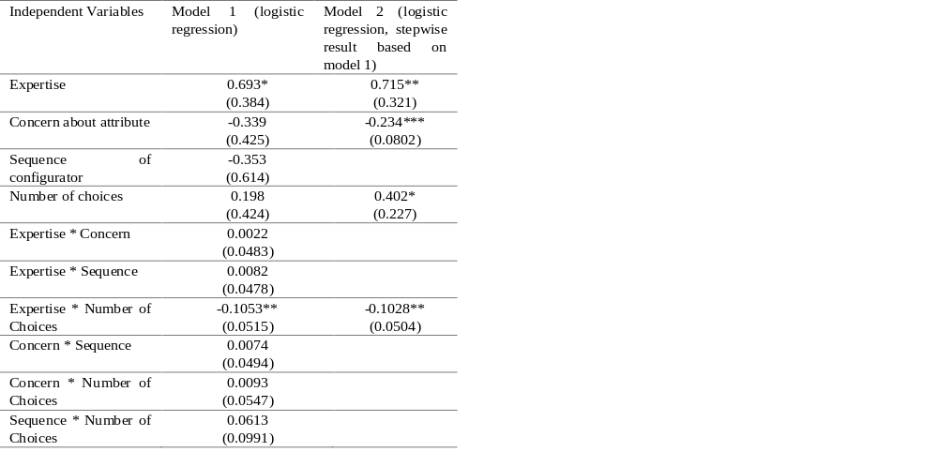
Which factors affect customers’ decision?
Relationship between response and different variables - laptop
*: p value< 0.1
**: p value< 0.05
***: p value< 0.01

Slide 15
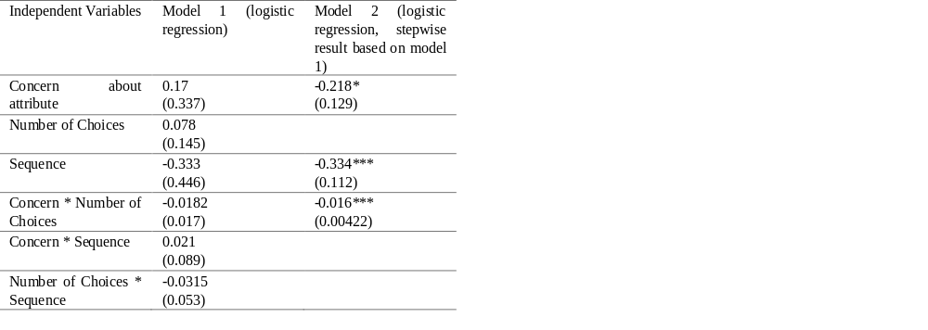
Which factors affect customers’ decision?
*: p value< 0.1
**: p value< 0.05
***: p value< 0.01

Slide 16
Conclusion
Default options affect consumers’ decision in configuration process
The significant factors
  utilitarian products: customers’ degree of expertise, the rating of the attribute importance, and the number of attribute choices are significant factors
  Hedonic products: the importance of the attributes and the configuring sequence are significant factors.

Slide 17
Future work
From lab experiment to field experiment
Order of attributes is fixed in this experiment. Flexible-order configurator will be tried.
Customers’ satisfaction to default choices

Slide 18
Questions?
yuewang@hsmc.edu.hk
Research Gate: Yue_Wang116
Github: yw57721

