Slide 1

CONFWS’18
How to deal with Engineering-to-Order Product/System Configuration?
Abdourahim Sylla, Delphine Guillon, Rania Ayachi, Elise Vareilles,
Michel Aldanondo, Thierry Coudert and Laurent Geneste.
September 28, 2018

Slide 2

How to deal with Engineering-to-Order Product/System Configuration? Before starting…….ATO, MTO, CTO….ETO
Before starting…….ATO, MTO, CTO….ETO
What happens when you "give your credit card” ?
ATO : assemble to order MTO : make to order PTO : pick to order
Cars, computers, kitchens Stairs, doors, windows, Ikea ?
For these situations the diversity proposed to the customer has been:
Identified, Discussed, Validated, and Inputted in the configurator
ATO and MTO are frequently gathered in CTO: configure to Order
Absolutely impossible to configure something out of previous diversity definition:
You can only select a crane of 6 or 8 meters but why not 7 or 9 ?
It can be possible, but it has never been engineered
If you say ok, you have to engineer the requirements and product solutions
This is ETO : Engineer To Order
Too bad to miss a business because of a single out of range requirement !
The idea, three level of diversity or requirements :
Standard ⬄ CTO
Non standard but acceptable ⬄ ETO
Non acceptable out of CTO-ETO diversity ranges ⬄ Full engineering problem

Slide 3
How to deal with Engineering-to-Order Product/System Configuration?
Agenda
  Context, research problems and objectives
  Systems configuration models in CTO
  Six cases of systems configuration in ETO
  Extension of configuration models from CTO towards ETO
  Conclusions and further research

Slide 4
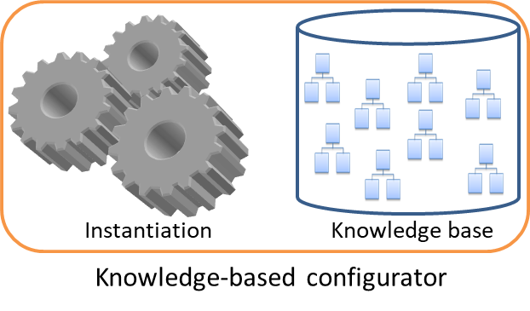
How to deal with Engineering-to-Order Product/System Configuration? Context and research problem
ETO
demands for
personalized system
demands for
personalized system
CTO
demands for
personalized system
PTO
ATO
MTO
System solutions space
proposes a
system solution
Client Company
proposes a
system solution
Supplier Company
The problem is the configuration hypothesis state that:
- a configured product/system is assembled from predefined or totally designed components/sub-systems
- the assembly mode is also predefined
- as a consequence, ETO products/systems cannot be configured using the existing configuration models
[Montanari1974, Mittal+1986, Aldanondo+2008, Felfernig+2014, Zhang2014]

Slide 5
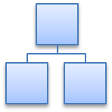
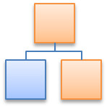
How to deal with Engineering-to-Order Product/System Configuration? Research objectives
Instantiation
Knowledge base
Knowledge-based configurator
This research focus on the generic model
The aim is to extend existing products/systems configuration models towards ETO
  Identify the cases of systems configuration that differentiate ETO from CTO
  For each case, to propose CSP-based modelling approach
  to extend existing configuration models from CTO to ETO

Slide 6
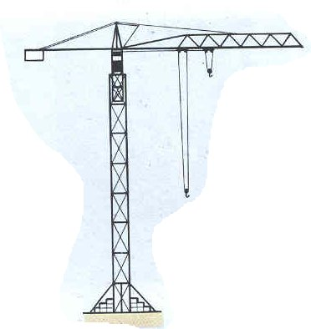
How to deal with Engineering-to-Order Product/System Configuration? Systems configuration model in CTO
Generic model of crane system
In CTO
Crane
Crane 1 : Jib 1, Tower 1
4m or 8m
Crane 2 : Jib 2, Tower 2
Jib
Tower
Jib 1
4 meters
Stiffness low
Jib 2
8 meters
Stiffness strong
Tower 1
Tower 2
8m
or
16m
Length
Length
4
4
Jib
Jib
8
Jib 1
Jib 1
Jib 2
Crane
Stiffness
Crane
CSP model
Stiffness
low
Crane 1
low
Crane 1
Tour
strong
Tower
Crane 2
Tour 1
Tower 1
System
Sub-system
properties
Tower 2
Sub-systems

Slide 7
How to deal with Engineering-to-Order Product/System Configuration? Les The six cases of systems configuration in ETO
Crane
Crane 1 : Jib 1, Tower 1
Crane 2 : Jib 2, Tower 2
Crane NS : Jib 1, Tower 2
Crane NS : Basket, Jib 1, Tower 1
Crane NS : Jib NS, Tower 2
Basket
Jib
Tower
Jib 1
4 meters
Stiffness low
Jib 2
8 meters
Stiffness strong
Tower 1
Tower 2
6 meters
Jib NS
6 meters
Stiffness strong
Jib NS
Specific shape
Jib NS
4 meters
Stiffness strong
Standard property values
Standard
associations
Standards sub-system instances
Standard
integrations
Standard
system solutions
Case 1
Case 4
Non-standard property values
Case 2
Non-standards sub-system instances
Case 5
Non-standard
system solutions
Case 6
Case 3
Non-standards properties
Non-standard
Sub-systems

Slide 8
How to deal with Engineering-to-Order Product/System Configuration? Extension of existing configuration models : case 2 and case 5
Length NS
6 meters
Stiffness strong
Length
4
8
Jib
Length
]4,8[
6
Jib 1
Jib 2
Crane
Jib
Jib _NS_AV
Crane 1
Jib _NS_AV
Crane 2
Stiffness
Crane
Crane _NS
low
Crane _NS
Stiffness
strong
Tower
System
strong
Sub-system
properties
Tower 1
Tower
Tower 2
Tower 2
Sub-systems
Case 2 : addition of non-standard values
for the properties
Case 5 : Addition of a non-standard sub-system to a system

Slide 9
How to deal with Engineering-to-Order Product/System Configuration? Consequences of the proposed approach on the supplier companies
Two major consequences on the supplier companies
  Identification of system features
    Standard
    Non-standard acceptable
    Non-acceptable
  Generic model updating
non-standard become a standard one
non-standard crane
Length
6
Jib
Jib 3
Jib _NS_AV
Crane
Crane 3
Stiffness
Crane _NS
strong
Tower
Tower 2
Length
4
8
Jib
Generic model of
the crane
6
Jib 1
]4,8[
5,7
Jib 2
Crane
jib 3
Crane 1
Jib _NS_AV
Crane 2
Stiffness
low
Crane 3
strong
Tour
Crane _NS
Sub-system
properties
Tour 1
System
Tour 2
Sub-systems

Slide 10
How to deal with Engineering-to-Order Product/System Configuration? Conclusion and further research
Conclusion :
Six cases that differentiate CTO systems configuration from ETO have been identified
For each case, a CSP-based modelling approach has been proposed in order to extend the existing models towards ETO
Based on that a generic model has been proposed for the configuration of CTO and ETO products/systems.
Further research :
to test the applicability of the proposals on a larger case of systems configuration
To extend the configuration of processes relevant to CTO towards ETO
To propose a method/scale to measure the distance between an ETO product/system and CTO products/systems.

